Slide 1
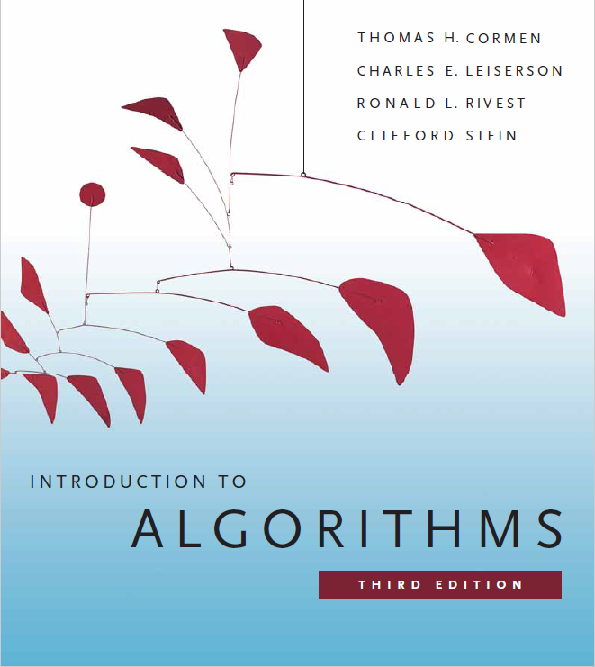
Search Trees
Prepared by Shmuel Wimer
Instructed by Deganit Armon and Shmuel Wimer

Slide 2
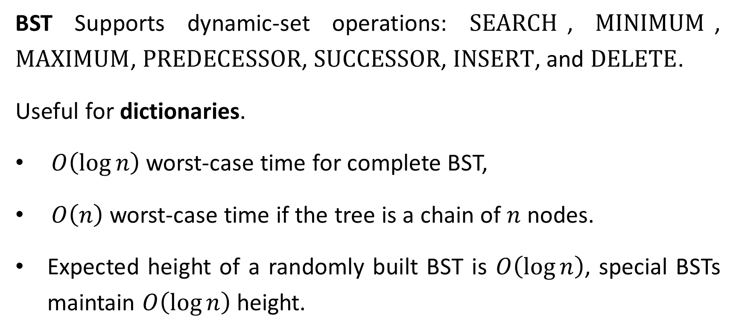
Binary Search Tree
BST Supports dynamic-set operations: $\text{SEARCH}$, $\text{MINIMUM}$, $\text{MAXIMUM}$, $\text{PREDECESSOR}$, $\text{SUCCESSOR}$, $\text{INSERT}$, and $\text{DELETE}$.
Useful for dictionaries.
$O\left(\log{n}\right)$ worst-case time for complete BST,
$O\left(n\right)$ worst-case time if the tree is a chain of $n$ nodes.
Expected height of a randomly built BST is $O\left(\log{n}\right)$, special BSTs maintain $O\left(\log{n}\right)$ height.

Slide 3
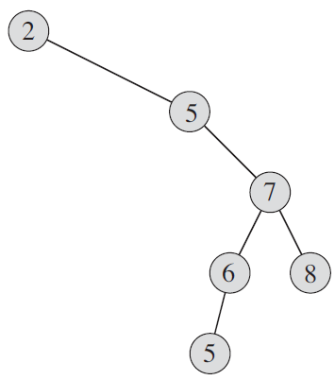
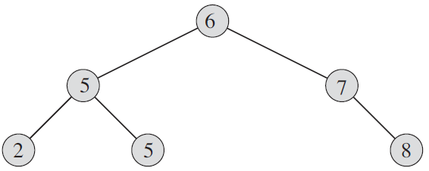

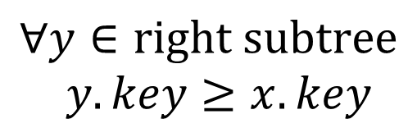
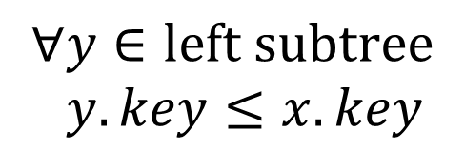


BST property
$$x$$
$$∀y∈\text{right} \text{subtree}$$
$$y.key≥x.key$$
$$∀y∈\text{left} \text{subtree}$$
$$y.key≤x.key$$
$$y$$
$$y$$

Slide 4
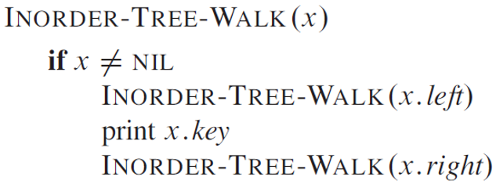
Nodes’ keys can be efficiently reported by an inorder traversal.
Node’s key (root) reported after all left subtree’s nodes and before right subtree’s nodes.
Postorder traversal reports root’s key after left and right subtrees.
Preorder traversal reports root’s key before left and right subtrees.

Slide 5
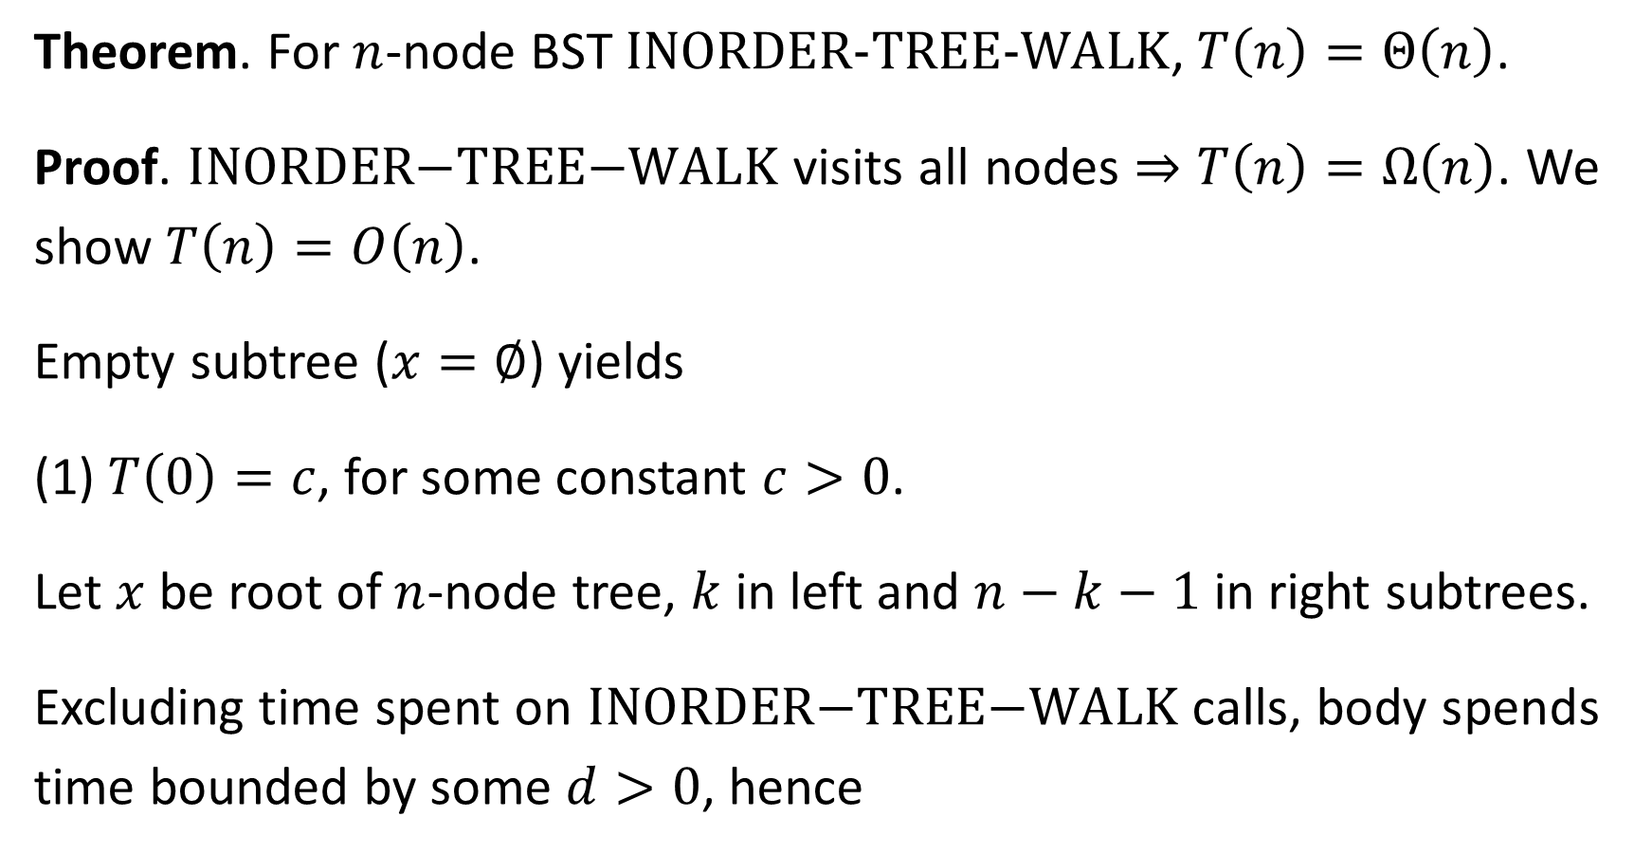
Theorem. For $n$-node BST $\text{INORDER}\text{−}\text{TREE}\text{−}\text{WALK}$, $T\left(n\right)=Θ\left(n\right)$.
Proof. $\text{INORDER}\text{−}\text{TREE}\text{−}\text{WALK}$ visits all nodes ⇒ $T\left(n\right)=Ω\left(n\right)$. We show $T\left(n\right)=O\left(n\right)$.
Empty subtree ($x=∅$) yields
(1) $T\left(0\right)=c$, for some constant $c>0$.
Let $x$ be root of $n$-node tree, $k$ in left and $n−k−1$ in right subtrees.
Excluding time spent on $\text{INORDER}\text{−}\text{TREE}\text{−}\text{WALK}$ calls, body spends time bounded by some $d>0$, hence

Slide 6
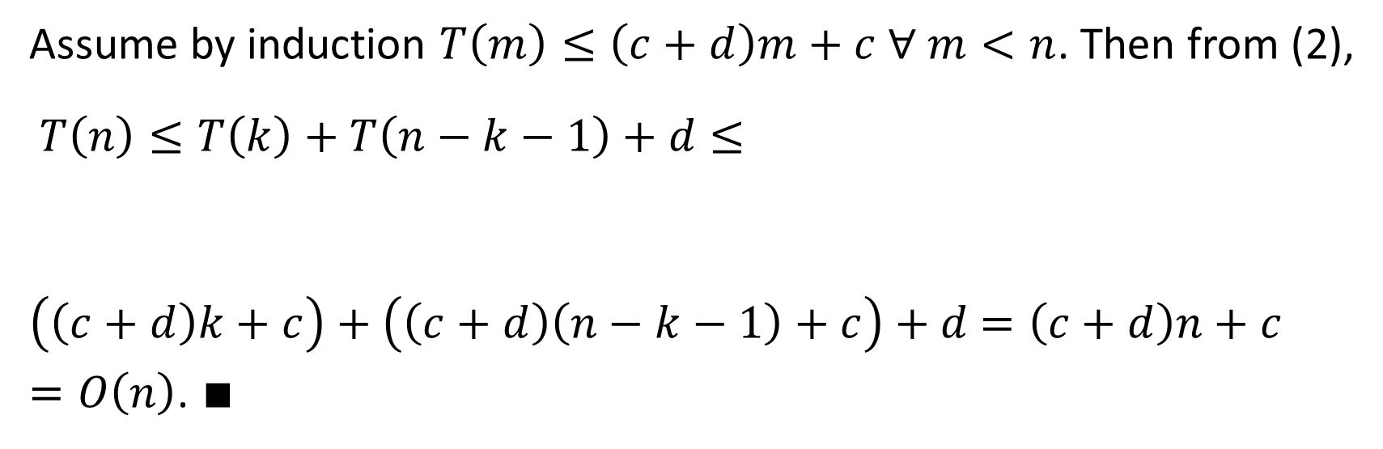
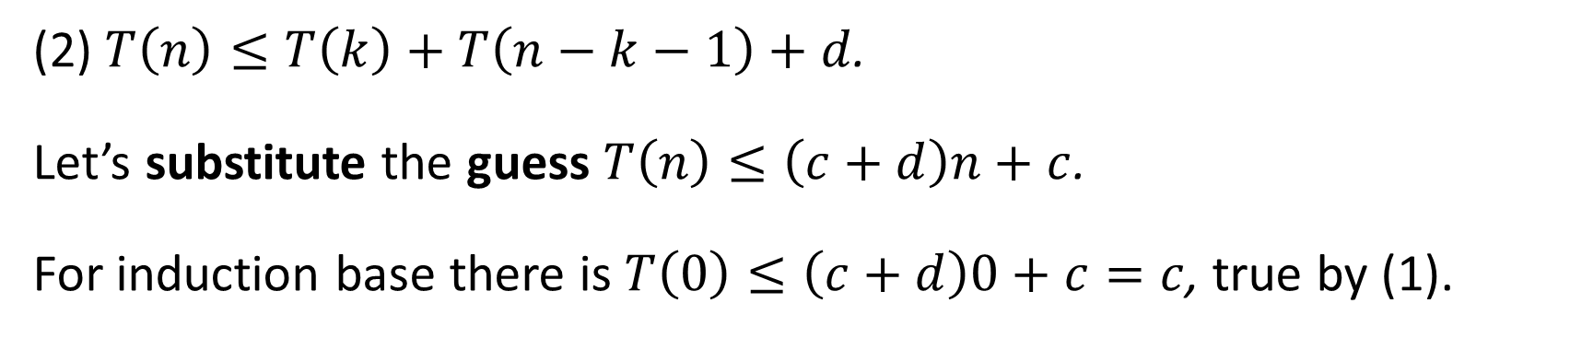
(2) $T\left(n\right)≤T\left(k\right)+T\left(n−k−1\right)+d$.
Let’s substitute the guess $T\left(n\right)≤\left(c+d\right)n+c$.
For induction base there is $T\left(0\right)≤\left(c+d\right)0+c=c$, true by (1).
Assume by induction $T\left(m\right)≤\left(c+d\right)m+c ∀ m<n$. Then from (2),
$T\left(n\right)≤T\left(k\right)+T\left(n−k−1\right)+d≤$
$\left(\left(c+d\right)k+c\right)+\left(\left(c+d\right)\left(n−k−1\right)+c\right)+d$ $=\left(c+d\right)n+c=O\left(n\right)$. $∎$
by induction
by induction

Slide 7
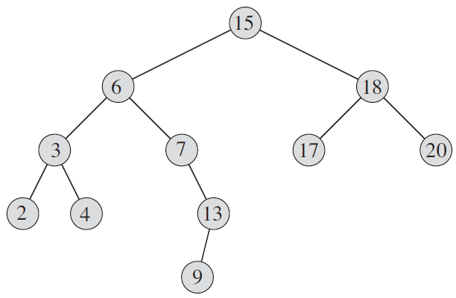

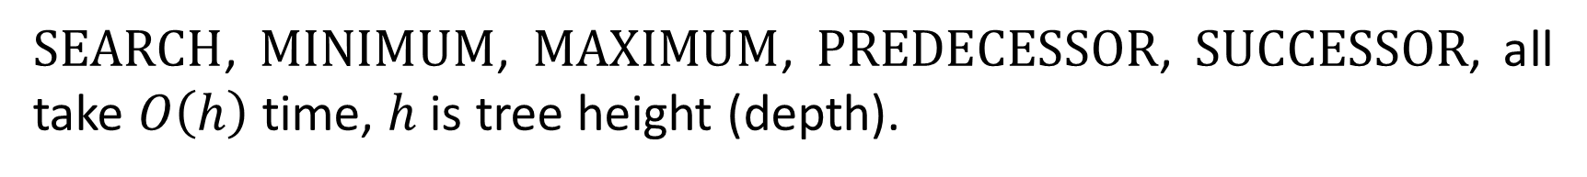



Querying
$\text{SEARCH}$, $\text{MINIMUM}$, $\text{MAXIMUM}$, $\text{PREDECESSOR}$, $\text{SUCCESSOR}$, all take $O\left(h\right)$ time, $h$is tree height (depth).
$13$ $< ?$
$13$ $< ?$
searching 13
$13$ $< ?$
$13$ $== ?$

Slide 8
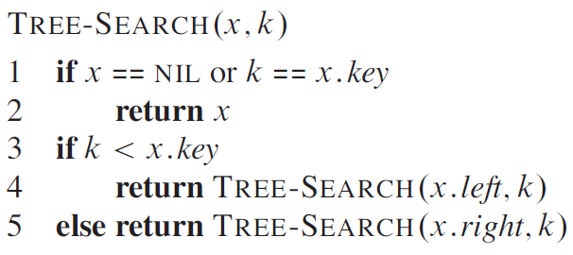
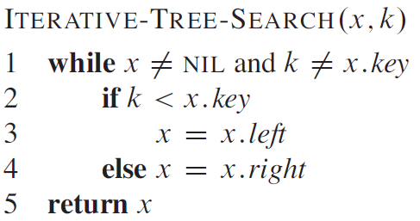
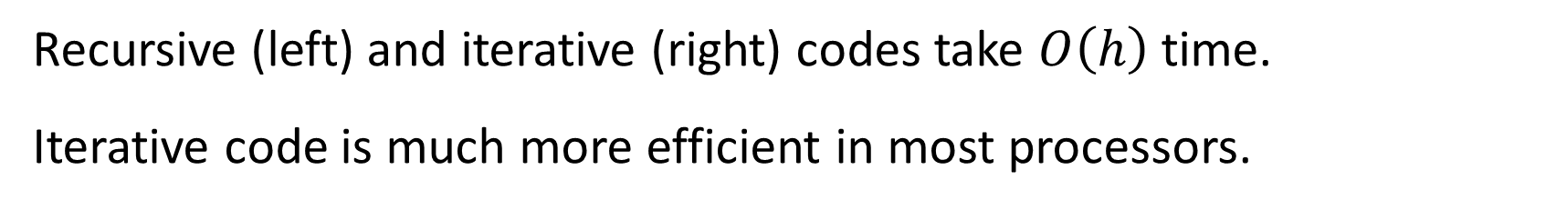
Recursive (left) and iterative (right) codes take $O\left(h\right)$ time.
Iterative code is much more efficient in most processors.
// found or not exists
// found or not exists

Slide 9
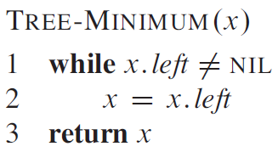
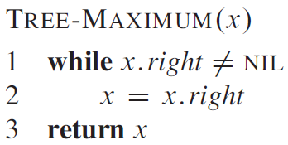
Minimum and maximum codes take $O\left(h\right)$ time.

Slide 10




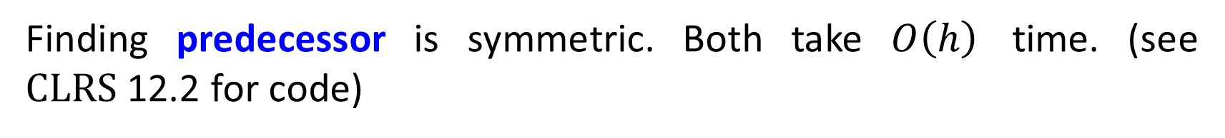
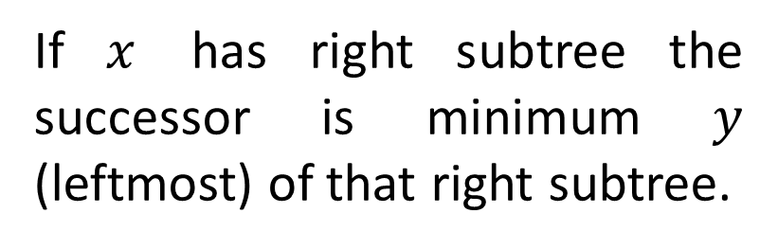
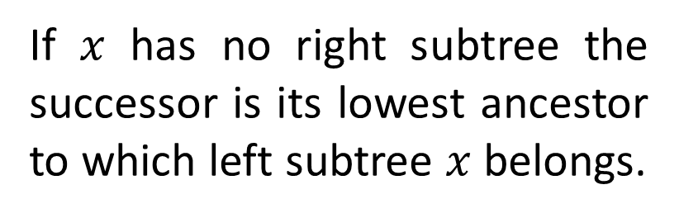
If a successor of $x$ exists it is found by either two cases.
$$x$$
$$y$$
$$x$$
$$y$$
If $x$ has right subtree the successor is minimum $y$ (leftmost) of that right subtree.
If $x$ has no right subtree the successor is its lowest ancestor to which left subtree $x$ belongs.
Finding predecessor is symmetric. Both take $O\left(h\right)$ time. (see $\text{CLRS}$12.2 for code)

Slide 11












Insertion and Deletion
$$13$$
$$12$$
$$13$$
$$5$$
$$18$$
$$13$$
$$2$$
$$9$$
$$15$$
$$19$$
$$13$$
$$17$$

Slide 12


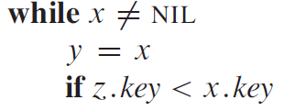

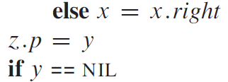





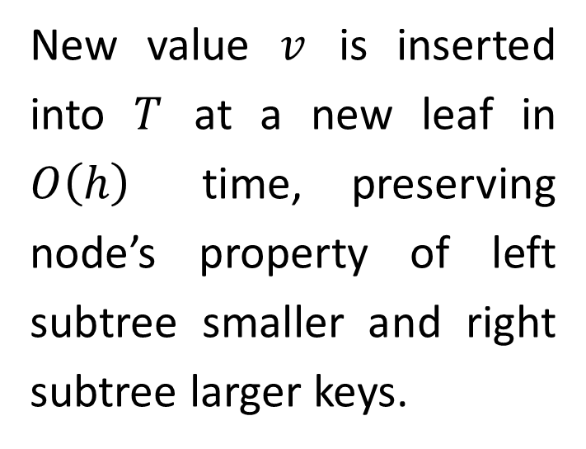
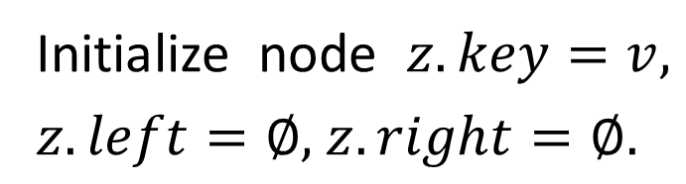
New value $v$ is inserted into $T$ at a new leaf in $O\left(h\right)$ time, preserving node’s property of left subtree smaller and right subtree larger keys.
// traverse to leaf
// add new leaf
// $T$ empty
Initialize node $z.key=v,$ $z.left=∅,$ $z.right=∅.$

Slide 13

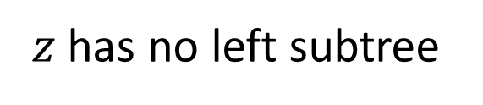

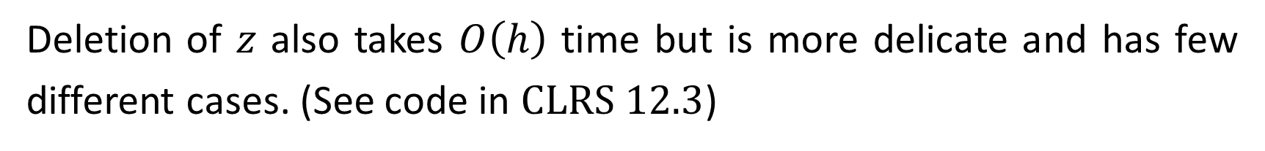
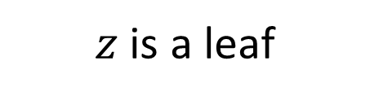








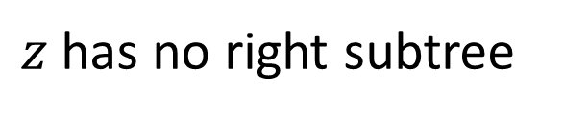



Deletion of $z$ also takes $O\left(h\right)$ time but is more delicate and has few different cases. (See code in $\text{CLRS} \text{12.3}$)
$z$ is a leaf
$z$ has no left subtree
$z$ has no right subtree
$$q$$
$$q$$
$$q$$
$$q$$
$$q$$
$$q$$
$$z$$
$$z$$
$$r$$
$$z$$
$$l$$
$$r$$
$$l$$

Slide 14
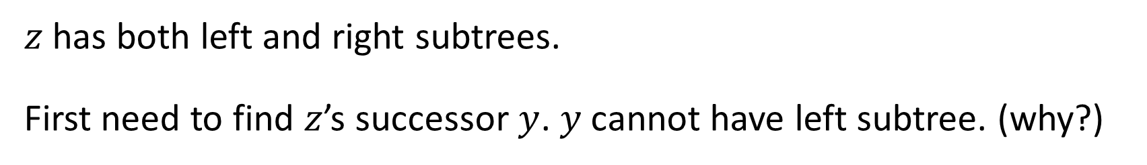









$z$ has both left and right subtrees.
First need to find $z$’s successor $y$. $y$cannot have left subtree. (why?)
If it is $z$’s right child, then replace $z$ by $y$.
$$q$$
$$q$$
$$z$$
$$y$$
$$l$$
$$y$$
$$l$$
$$x$$
$$x$$

Slide 15



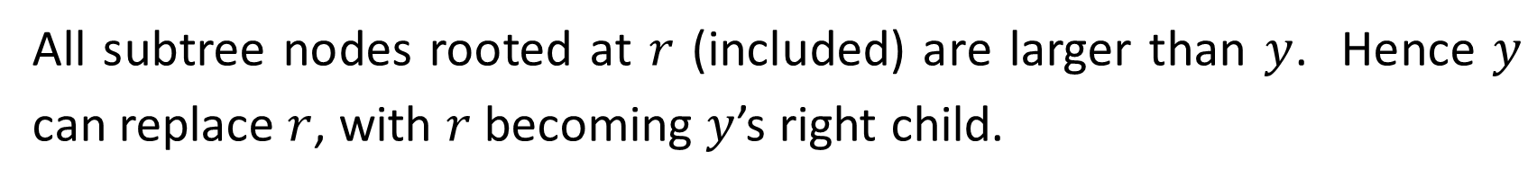














Otherwise, $y$is the leftmost in $z$’s right subtree.
All subtree nodes rooted at $r$ (included) are larger than $y$. Hence $y$ can replace $r$, with $r$becoming $y$’s right child.
$$q$$
$$q$$
$$q$$
$$z$$
$$z$$
$$y$$
$$y$$
$$l$$
$$r$$
$$l$$
$$r$$
$$l$$
$$r$$
$$y$$
$$x$$
$$x$$
$$x$$

Slide 16
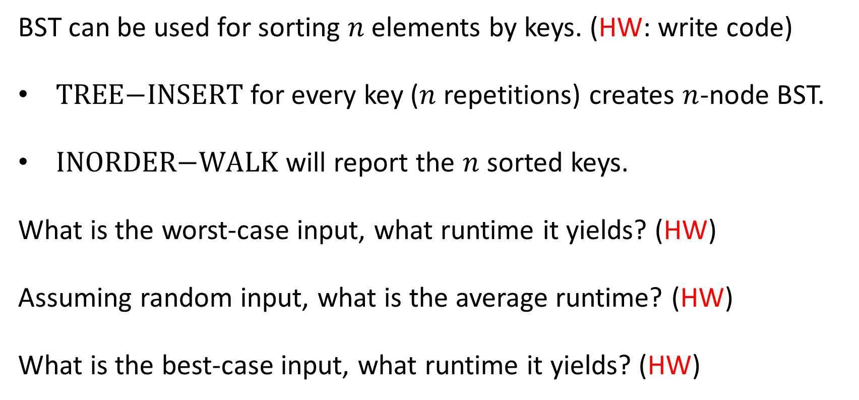
Sorting with BST
BST can be used for sorting $n$elements by keys. (HW: write code)
$\text{TREE}\text{−}\text{INSERT}$ for every key ($n$ repetitions) creates $n$-node BST.
$\text{INORDER}\text{−}\text{WALK}$ will report the $n$ sorted keys.
What is the worst-case input, what runtime it yields? (HW)
Assuming random input, what is the average runtime? (HW)
What is the best-case input, what runtime it yields? (HW)

Slide 17



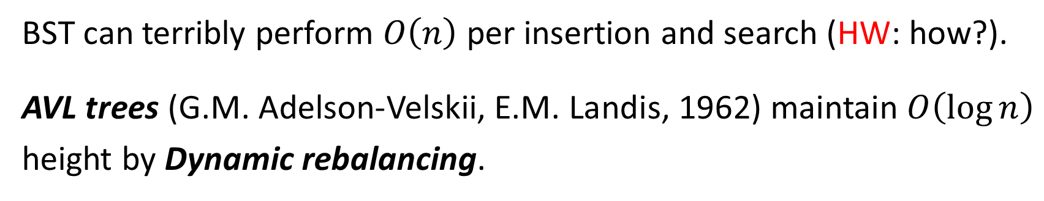














AVL Trees
BST can terribly perform $O\left(n\right)$ per insertion and search (HW: how?).
AVL trees (G.M. Adelson-Velskii, E.M. Landis, 1962) maintain $O\left(\log{n}\right)$ height by Dynamic rebalancing.
$$0$$
$$8$$
$$1$$
$$5$$
$$11$$
$$2$$
$$3$$
$$7$$
$$12$$
$$10$$
$$3$$
$$2$$
$$4$$
$$6$$
$$9$$
$$4$$
$$1$$
Balance invariance: left and right subtrees depth differ at most by 1.

Slide 18
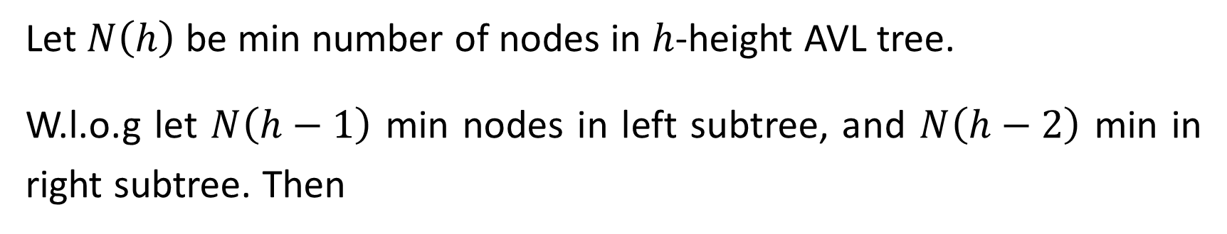


Worst (imbalanced) AVL: 1 height diff occurs at all nodes. Otherwise leaves could be dropped without harming the invariance.
Let $N\left(h\right)$ be min number of nodes in $h$-height AVL tree.
W.l.o.g let $N\left(h−1\right)$ min nodes in left subtree, and $N\left(h−2\right)$ min in right subtree. Then
$$N\left(h\right)=N\left(h−1\right)+N\left(h−2\right)+1$$
$$N\left(h−2\right)$$
$$N\left(h−1\right)$$

Slide 19
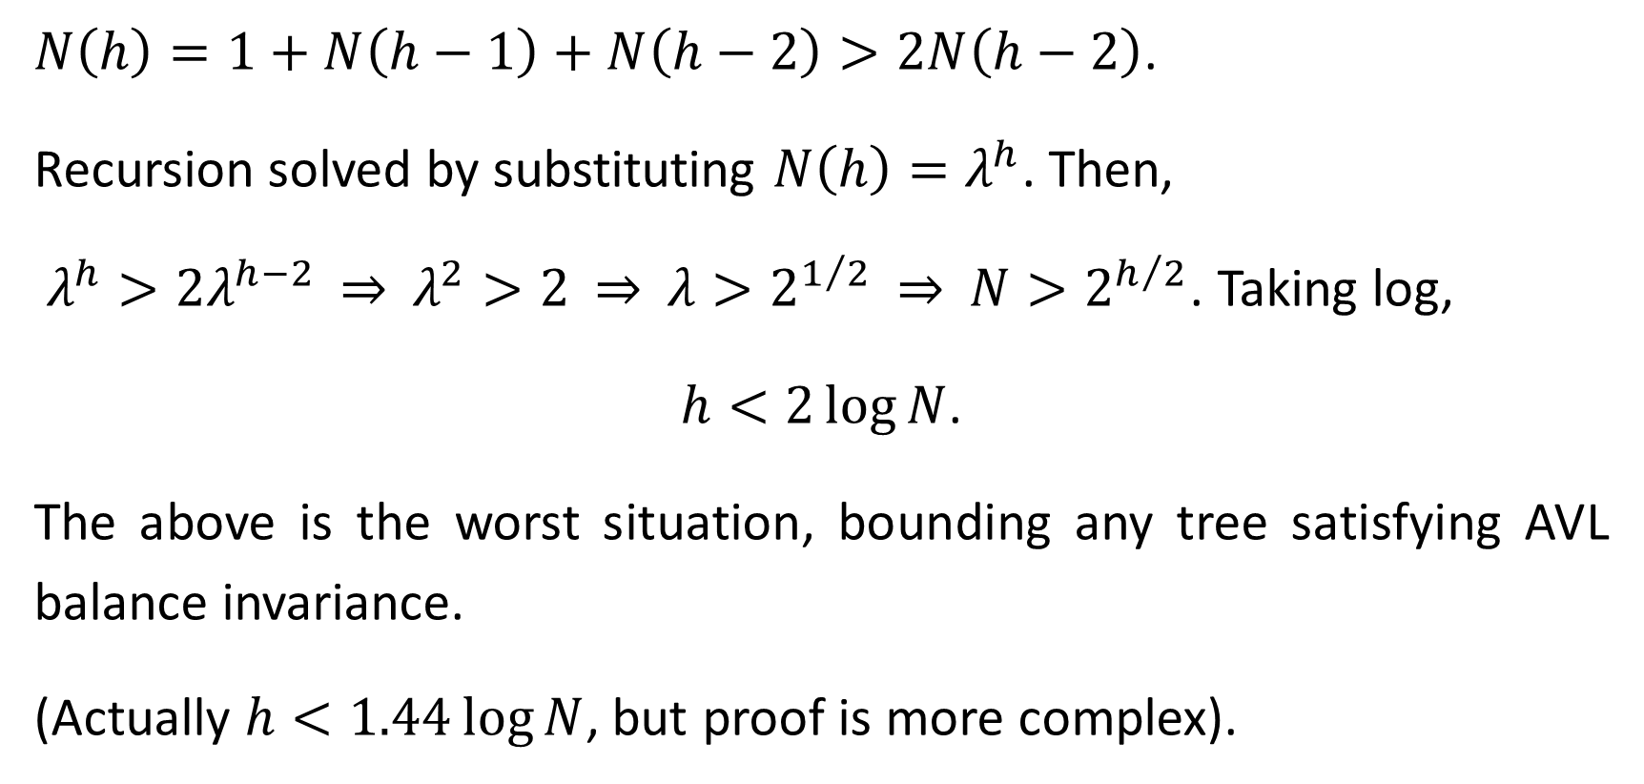
$N\left(h\right)=1+N\left(h−1\right)+N\left(h−2\right)>2N\left(h−2\right)$.
Recursion solved by substituting $N\left(h\right)=λ^{h}$. Then,
$λ^{h}>2λ^{h−2}$ ⇒ $λ^{2}>2$ ⇒ $λ>2^{1/2}$ ⇒ $N>2^{h/2}$. Taking log,
$h<2\log{N}$.
The above is the worst situation, bounding any tree satisfying AVL balance invariance.
(Actually $h<1.44\log{N}$, but proof is more complex).

Slide 20
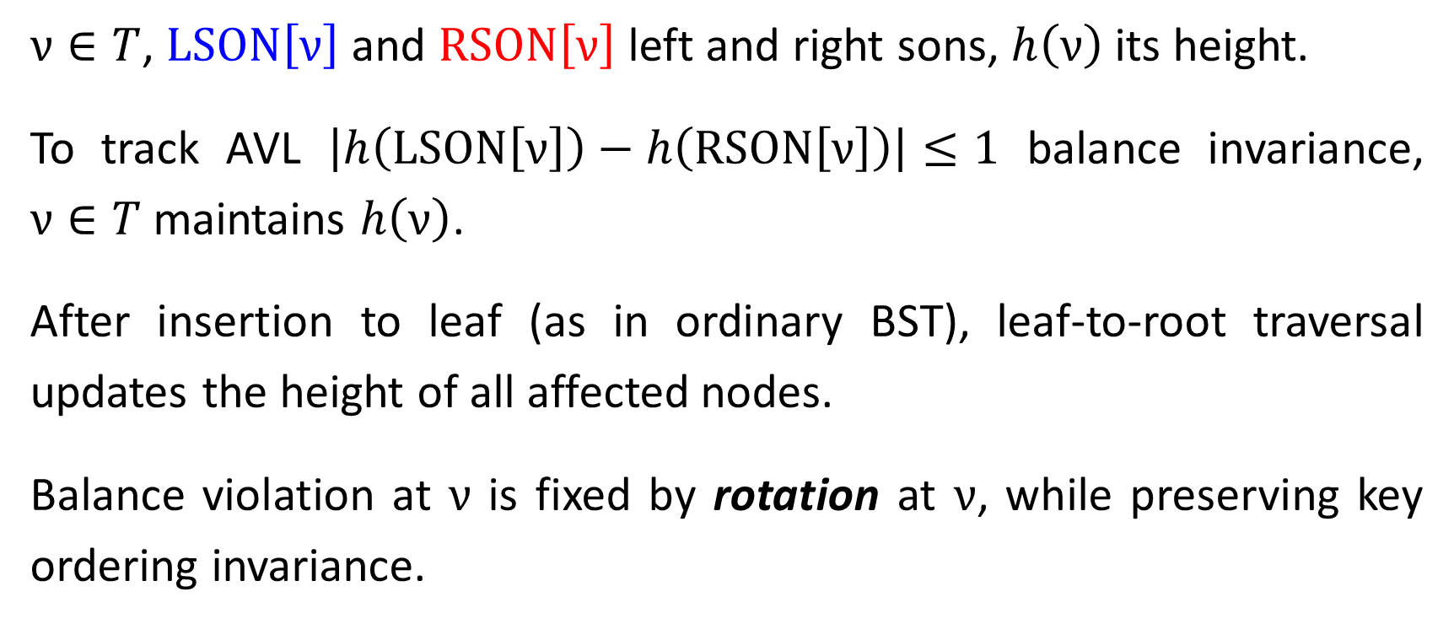
Insertion in AVL Tree
$ν∈T$, $\text{LSON}\left[ν\right]$ and $\text{R}\text{SON}\left[ν\right]$ left and right sons, $h\left(ν\right)$ its height.
To track AVL $\left|h\left(\text{LSON}\left[ν\right]\right)−h\left(\text{R}\text{SON}\left[ν\right]\right)\right|≤1$ balance invariance, $ν∈T$ maintains $h\left(ν\right)$.
After insertion to leaf (as in ordinary BST), leaf-to-root traversal updates the height of all affected nodes.
Balance violation at $ν$ is fixed by rotation at $ν$, while preserving key ordering invariance.

Slide 21



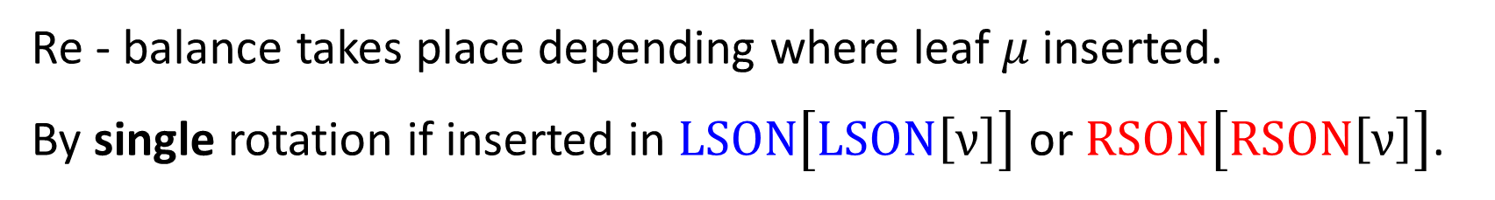















Re - balance takes place depending where leaf $μ$inserted.
By single rotation if inserted in $\text{LSON}\left[\text{LSON}\left[ν\right]\right]$ or $\text{R}\text{SON}\left[\text{RSON}\left[ν\right]\right]$.
Balance violation
$$ν$$
right rotation
$$ω$$
$$ν$$
$$ω$$
$$Z$$
$$X$$
$$Y$$
$$Z$$
$$Y$$
$$h$$
$$h+1$$
$$X$$
$$h$$
$$h$$
$$h$$
$$μ$$
$$h+1$$
$$μ$$

Slide 22




















By double rotation if inserted in $\text{LSON}\left[\text{RSON}\left[ν\right]\right]$ or $\text{RSON}\left[\text{LSON}\left[ν\right]\right]$.
Balance violation
$$ν$$
2nd
$$ν$$
$$ω$$
$$ω$$
1st
$$Z$$
$$Z$$
$$X$$
$$h$$
$$X$$
$$h$$
$$Y$$
$$γ$$
$$h$$
$$h$$
$$h+1$$
$$μ$$
$$V$$
$$W$$
$$h$$
$$μ$$
$$h$$
$$μ$$
Right rotation alone does not solve the imbalance.
$Y$ subtree splits into $V$ and $W$. Either $μ∈V$ or $μ∈W$.

Slide 23






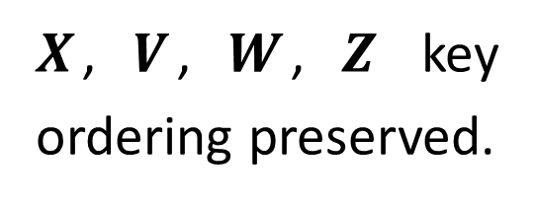




















Balance restored by two rotations: 1st left, 2nd right.
$$ν$$
after left rotation
$X$, $V$, $W$, $Z$ key ordering preserved.
$$γ$$
$$Z$$
$$W$$
$$h$$
$$ω$$
$$h$$
after right rotation
$$μ$$
$$X$$
$$V$$
$$γ$$
$$h$$
$$h$$
$$μ$$
$$ω$$
$$ν$$
$$X$$
$$V$$
$$W$$
$$Z$$
$$h$$
$$h$$
$$μ$$
$$h$$
$$μ$$
$$h$$

Slide 24
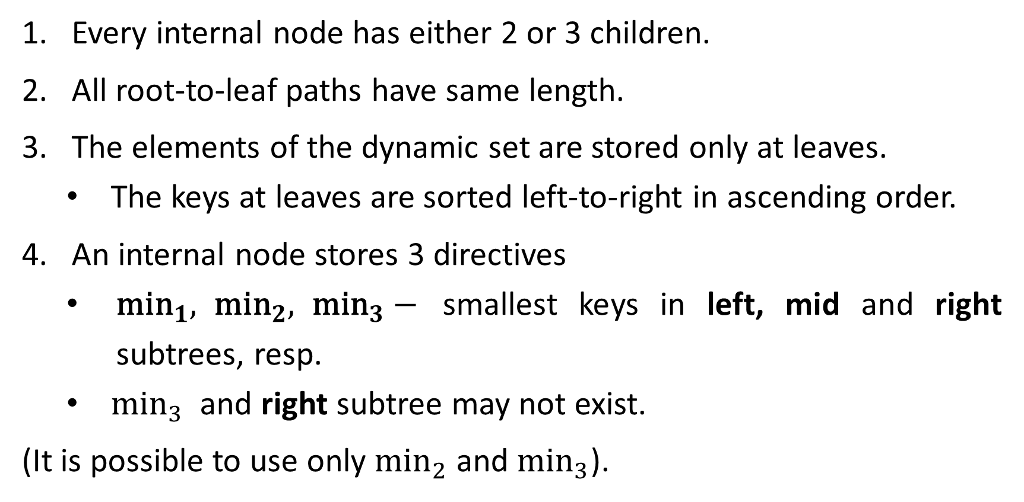
2-3 Trees
Every internal node has either 2 or 3 children.
All root-to-leaf paths have same length.
The elements of the dynamic set are stored only at leaves.
The keys at leaves are sorted left-to-right in ascending order.
An internal node stores 3 directives
${\text{min}}_{1}, {\text{min}}_{2}, {\text{min}}_{3}−$ smallest keys in left, mid and right subtrees, resp.
${\text{min}}_{3}$ and right subtree may not exist.
(It is possible to use only ${\text{min}}_{2}$ and ${\text{min}}_{3}$).

Slide 25
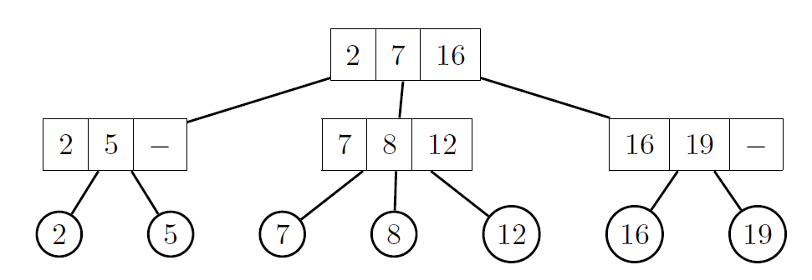
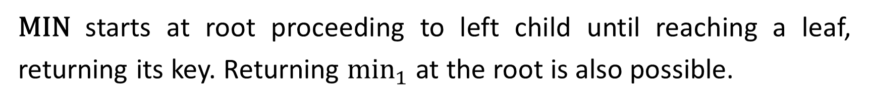
2-3 Tree Operations
$\text{MIN}$ starts at root proceeding to left child until reaching a leaf, returning its key. Returning ${\text{min}}_{1}$ at the root is also possible.
$\text{M}\text{AX}$ works similarly with right subtrees.

Slide 26
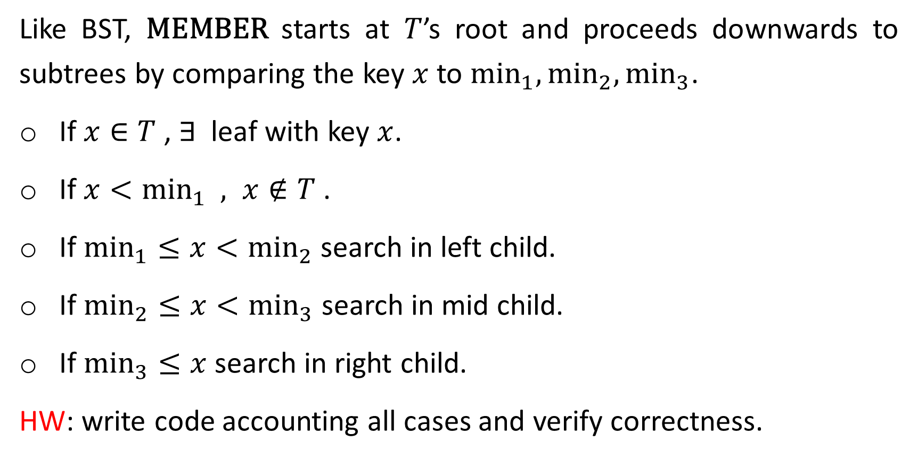
Like BST, $\text{MEMBER}$ starts at $T$’s root and proceeds downwards to subtrees by comparing the key $x$to ${\text{min}}_{1},{\text{min}}_{2},{\text{min}}_{3}$.
If $x∈T$ , $∃$ leaf with key $x$.
If $x<{\text{min}}_{1} , x∉T$.
If ${\text{min}}_{1}≤x<{\text{min}}_{2}$ search in left child.
If ${\text{min}}_{2}≤x<{\text{min}}_{3}$ search in mid child.
If ${\text{min}}_{3}≤x$ search in right child.
HW: write code accounting all cases and verify correctness.

Slide 27
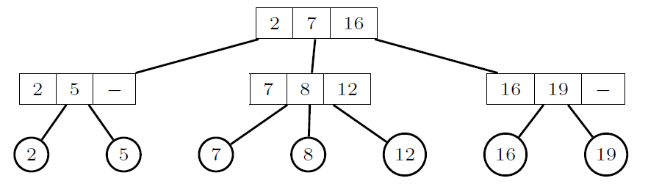
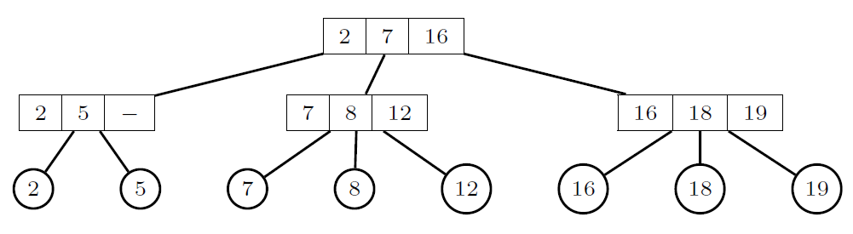



$$18$$
$$\text{I}NSERT$$
$$18$$

Slide 28
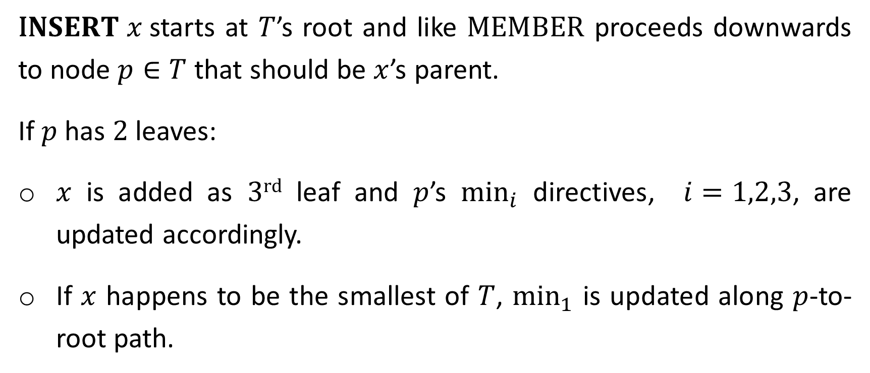
$\text{I}NSERT x$starts at $T$’s root and like $\text{MEMBER}$ proceeds downwards to node $p∈T$ that should be $x$’s parent.
If $p$ has $2$ leaves:
$x$ is added as $3\text{rd}$ leaf and $p$’s ${\text{min}}_{i}$ directives, $i=1,2,3$, are updated accordingly.
If $x$ happens to be the smallest of $T$, ${\text{min}}_{1}$ is updated along $p$-to-root path.

Slide 29
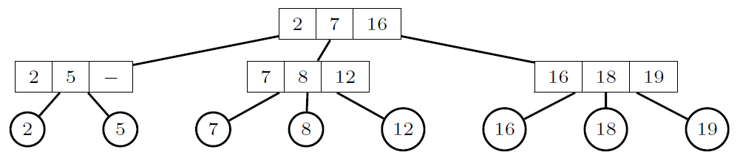
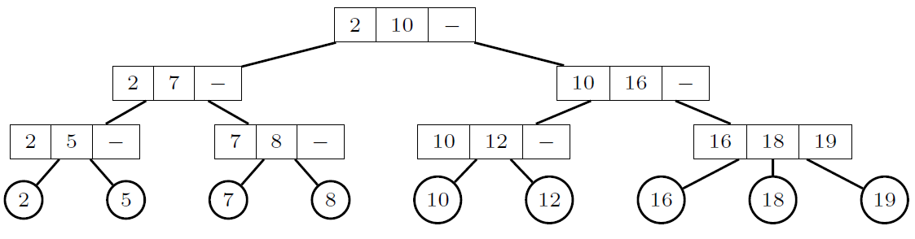








$$10$$
$$r$$
$$10$$
$$p$$
new root
$$r^{′}$$
split old root
$$r^{′′}$$
$$p^{′}$$
$$p^{′′}$$

Slide 30
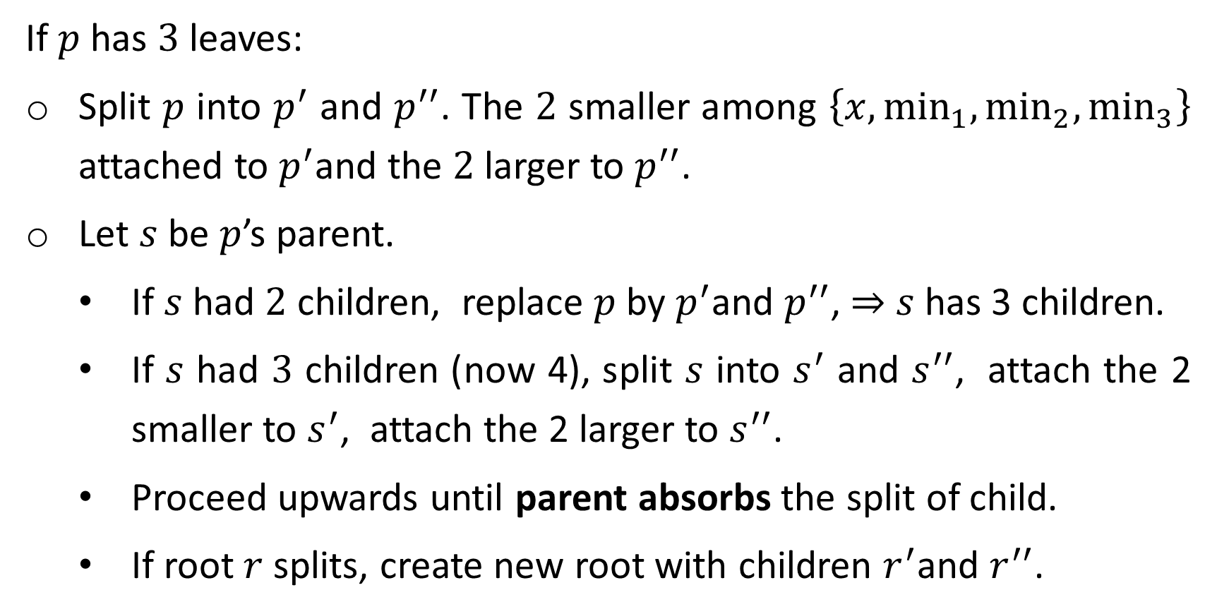
If $p$ has $3$ leaves:
Split $p$ into $p^{′}$ and $p^{′′}$. The $2$ smaller among $\left\{x,{\text{min}}_{1},{\text{min}}_{2},{\text{min}}_{3}\right\}$ attached to $p^{′}$and the $2$larger to $p^{′′}$.
Let $s$ be $p$’s parent.
If $s$ had $2$ children, replace $p$ by $p^{′}$and $p^{′′}$, ⇒ $s$has 3 children.
If $s$ had $3$ children (now 4), split $s$ into $s^{′}$ and $s^{′′}$, attach the 2 smaller to $s^{′}$, attach the 2 larger to $s^{′′}$.
Proceed upwards until parent absorbs the split of child.
If root $r$splits, create new root with children $r^{′}$and $r^{′′}$.

Slide 31
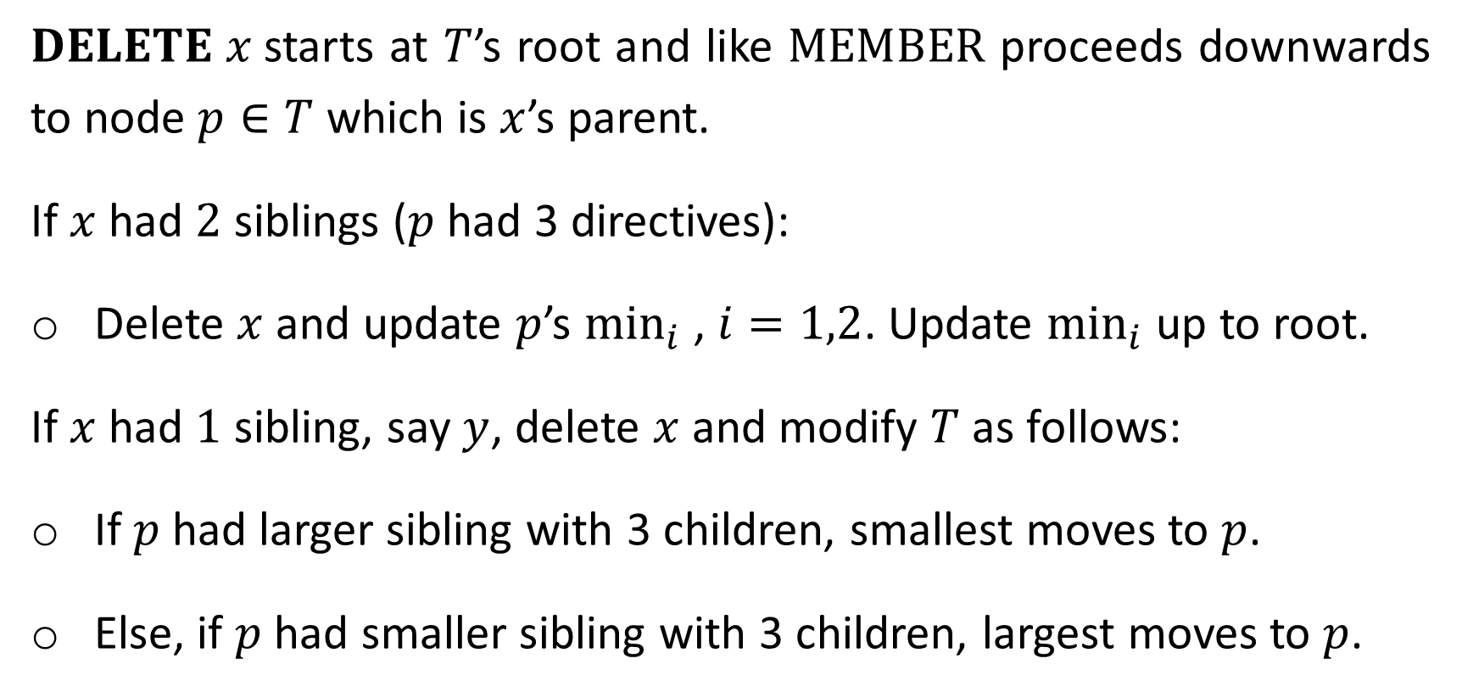
$DELETE x$starts at $T$’s root and like $\text{MEMBER}$ proceeds downwards to node $p∈T$ which is $x$’s parent.
If $x$ had $2$ siblings ($p$had 3 directives):
Delete $x$ and update $p$’s ${\text{min}}_{i}$ , $i=1,2$. Update ${\text{min}}_{i}$ up to root.
If $x$ had $1$ sibling, say $y$, delete $x$ and modify $T$as follows:
If $p$ had larger sibling with 3 children, smallest moves to $p$.
Else, if $p$ had smaller sibling with 3 children, largest moves to $p$.

Slide 32
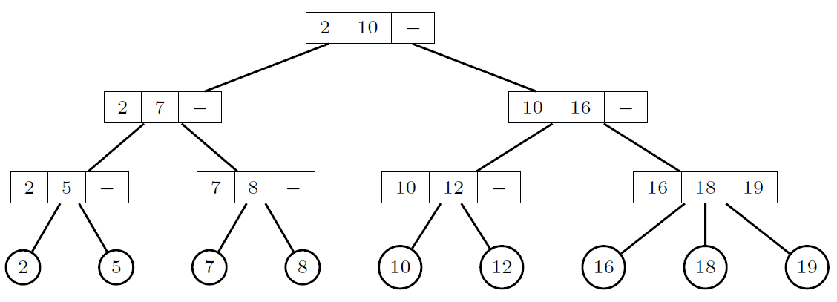
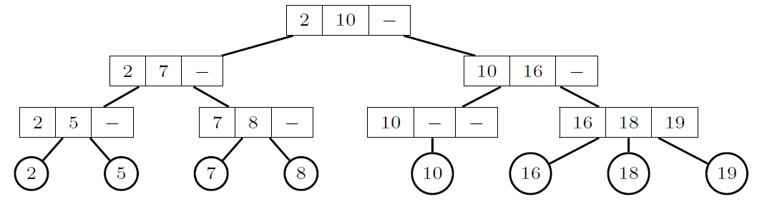










$$12$$
$$12$$
$$12$$
$$p$$
$$y$$
$$x$$
$$p$$
$$y$$
$$p$$
$$y$$

Slide 33

Else $p$ had siblings with only $2$ children:
$x$’s sibling $y$moves to $p$’s sibling as $3$^{rd} child and $p$ is deleted.
If $p$’s parent had $3$ children $2$ are left and we are done.
Otherwise, we proceed recursively upwards.

Slide 34











$$7$$
$$7$$
$$7$$
2 children yielding 3 subtrees merged in parent
$$p$$
$$x$$
$$y$$
imbalanced
$$?$$
$$y$$

Slide 35

Complexities of Operations
Claim: The $n$ leaves of 2-3 tree of height $h$ satisfy $2^{h}≤$ $n$ $≤3^{h}$.
Proof: By induction on $h$. For $h=1$ there are $2$ or $3$ leaves.
By induction, at root’s sons, there is $2^{h−1}≤$ $n_{i}$ $≤3^{h−1}$, $i=1,2,$($3$).
The root has either $2$ or $3$ sons, so
$2^{h}=2∙2^{h−1}≤n_{1}+n_{2}≤{n≤n}_{1}+n_{2}+n_{3}≤3∙3^{h−1}=3^{h}$. ∎
Corollary: A 2-3 tree with $n$ leaves has height $h=Θ\left(\log{n}\right)$. (HW)
Corollary: $\text{INSERT}$ and $\text{DELETE}$ complexity is $T\left(n\right)=Θ\left(\log{n}\right)$. (HW)

Slide 36
Supplementary

Slide 37

Random BSTs
All operations are $O\left(h\right)$, so what is $O\left(h\right)$? ($\text{CLRS} \text{12.4}$)
$h$ depends on the order and the values of inserted and deleted keys.
Study only random insertions and assume w.l.o.g keys are $\left\{1,2,…,n\right\}$.
Let the root’s key $R_{n}$ chosen randomly uniformly from $\left\{1,2,…,n\right\}$ so $\text{Pr}\left(R_{n}=i\right)=1/n$.
$R_{n}=i$ ⇒ $\left\{1,2,…,i−1\right\}$ and $\left\{i+1,2,…,n\right\}$ reside in randomly built left and right subtrees, independent of each other.

Slide 38







$X_{n}$ random variable: height of randomly built BST of $\left\{1,2,…,n\right\}$.
If $R_{n}=i$ (chosen randomly) then
$$X_{n}=1+\max\left(X_{i−1},X_{n−i}\right).$$
$$i$$
$$X_{n}$$
$$X_{i−1}$$
$$X_{n−i}$$
$$\left\{1,…,i−1\right\}$$
$$\left\{i+1,…,n\right\}$$

Slide 39



Define random variable $Y_{n}=2^{X_{n}}$, then
(1) $Y_{n}=2^{1+\max\left(X_{i−1},X_{n−i}\right)}=2\max\left(Y_{i−1},Y_{n−i}\right).$
Define random variables $Z_{n,i}$ , $1≤i≤n$: $Z_{n,i}=\left\{\begin{matrix}1 & \text{if}{ R}_{n}=i \\ 0 & \text{if}{ R}_{n}≠i\end{matrix}\right.$, ⇒
(2) $E\left[Z_{n,i}\right]=1∙\text{Pr}\left(R_{n}=i\right)+0∙\text{Pr}\left(R_{n}≠i\right)=1/n$.
mean, average
Choosing $R_{n}=i$, subtrees randomly built on $i−1$ and $n−i$ keys.
Other than number of keys, subtrees’ structure not affected by the choice $R_{n}=i$.

Slide 40





$Z_{n,i}$, $Y_{i−1}$ and $Y_{n−i}$ are all independent of each other, hence (1) ⇒
$E$linearity
(2)
Independence: $\text{E}\left[XY\right]=\text{E}\left[X\right]\text{E}\left[Y\right]$
$$E\left[Y_{n}\right]=E\left[\sum_{i=1}^{n}{Z_{n,i}\left(2∙max\left(Y_{i−1},Y_{n−i}\right)\right)}\right]=$$
$\frac{2}{n}\sum_{i=1}^{n}{E\left[\max\left(Y_{i−1},Y_{n−i}\right)\right]}≤$
$\frac{2}{n}\sum_{i=1}^{n}{\left(E\left[Y_{i−1}\right]+E\left[Y_{n−i}\right]\right)}=\frac{4}{n}\sum_{i=0}^{n−1}{E\left[Y_{i}\right]}$.
⇒ $E\left[Y_{n}\right]$ is recursive.
summands appear twice
(HW: Show $E\left[Y_{n}\right]≤\frac{1}{4}\left(\begin{matrix}n+3 \\ 3\end{matrix}\right)$ by substitution, $\text{CLRS}\text{ 12.4}$).

Slide 41





Definition: $g\left(x\right)$ is convex if
$μg\left(x_{1}\right)+\left(1−μ\right)g\left(x_{2}\right)≥g\left(μx_{1}+\left(1−μ\right)x_{2}\right), 0≤μ≤1$.
$$g\left(x\right)$$
$$x$$
$$x_{1}$$
$$x_{2}$$

Slide 42



For convex function $g$of a random variable $X$ there is
$\text{E}\left[g\left(X\right)\right]≥g\left(\text{E}\left[X\right]\right)$, provided that $\text{E}$ exists and finite. (HW)
$f\left(x\right)=2^{x}$ is convex ($f^{′′}>0$) ⇒
$$2^{\text{E}\left[X_{n}\right]}≤\text{E}\left[2^{X_{n}}\right]=\text{E}\left[Y_{n}\right]≤\frac{1}{4}\left(\begin{matrix}n+3 \\ 3\end{matrix}\right)=O\left(n^{3}\right)$$
Log of both sides ⇒ $\text{E}\left[X_{n}\right]=O\left(\log{n}\right)$. $∎$
$$g\left(\text{E}\left[X\right]\right)≤\text{E}\left[g\left(X\right)\right]$$

